Slide 1


Images Worth A Million Words
Vishal Sandesara and Karl Ni
October 2016
Notes:
Speaker intro
Quick lines about lab:
Lab41 is a Data Science Lab in Menlo Park, CA focused on solving data analytics problems plaguing the US Intelligence Community.

Slide 2


TODAY’S AGENDA
Objective
Background
Issues
Tech Discussion: The Attalos Challenge
Performance Results
Demonstration
Contact Us!
Notes:
Today we will present one such challenge we worked on.

Slide 3
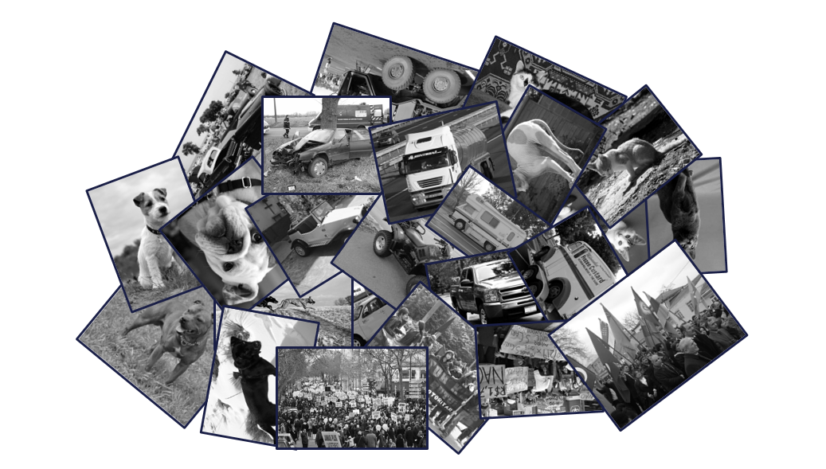
Training a Deep Learner on Open Source Imagery
Notes:
Training an image classifier is fairly common these days, however the
Novel thing about our classifier is that we want to Train it on user generated content in contrast to a lot of current networks trained on the imagenet 1000 class vocab
We expect that by training with open source imagery, we can enable classifying anything using potentially the entirety of the English language as a vocabulary!
This sort of capability would really help me because of how I currently deal with image search.
I can describe myself as an analog to a lot of the customers we work with.

Slide 4
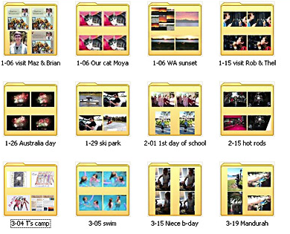
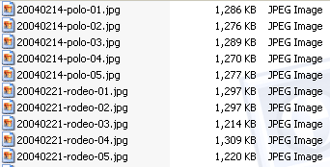
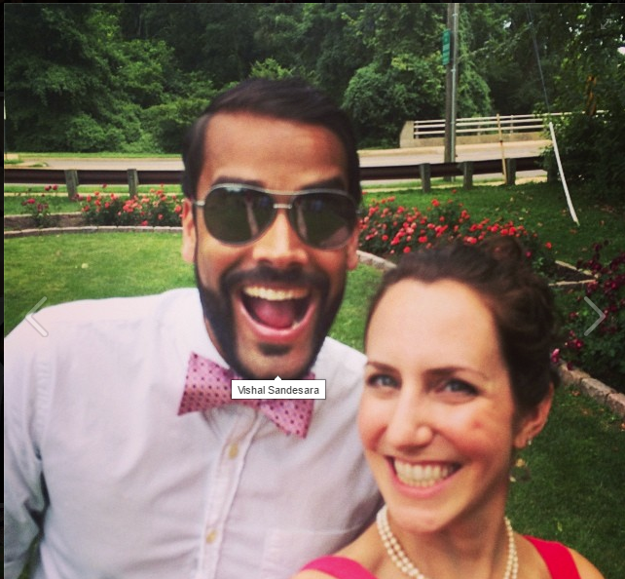
How I “Classify”
Notes:
So I’m getting married in December,
Fiance wants me to find pictures of us for our wedding slideshow and invites.
Long while back, I used to carefully setup my photo library. Folders with names, filenames with meaning. I could manually find the photo or photos I was looking for.
Start with locating the properly titled folder in my collection, then browse through the descriptive filenames, and voila, locate the picture I was looking for! This worked well as long as I maintained the quality of my library labelling.
Well I got lazy. I ended up collected way too many photos than I could keep up with and I ended up just dumping them all into one folder, with no logic or descriptive labelling.
It would take way too much time to keep up with my organization scheme! Thumbs DOWN!

Slide 5
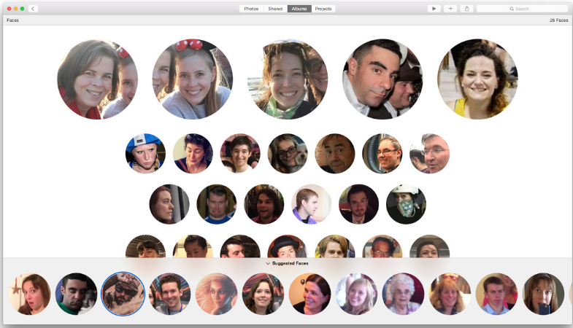
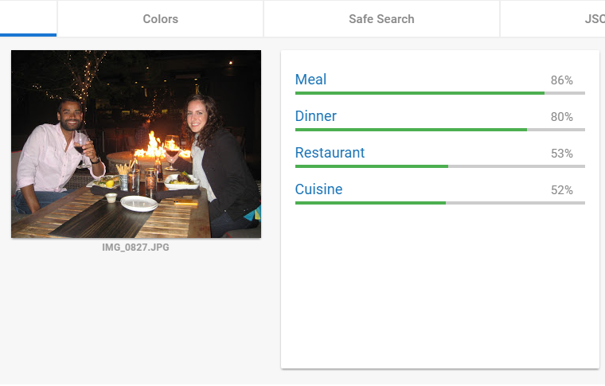
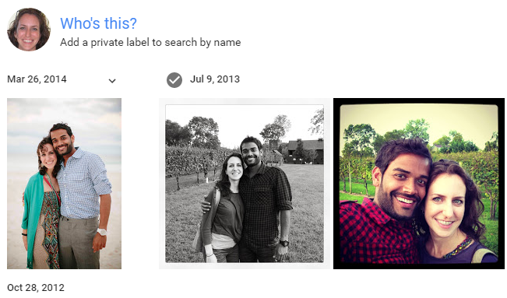


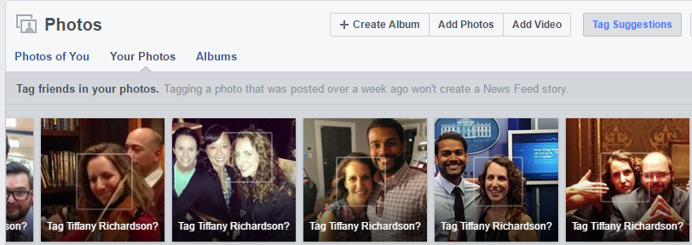
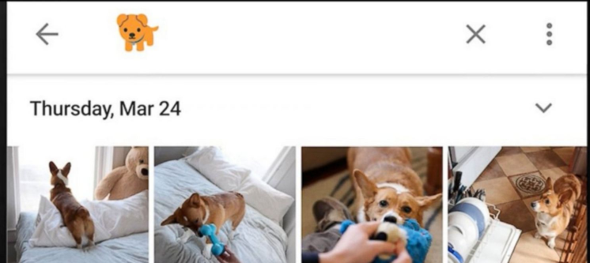

How Others Classify
Notes:
So I turned to readily available online tools.
Apple photos and Facebook helped out a great deal with facial recognition. By uploading my collection to these apps
Google analyzes things beyond faces, and that’s good, but it’s a limited vocabulary. Pink shirt might not be in vocab.
Additionally, if you are a business or a govt org , you may not want to upload all your data to the internet for this type of image analysis like I did.

Slide 6

A Need For Something More
Large Vocabulary
Leverage Noisy Data
Type in any search term and get back images that match
Multi-Concept Images
Notes:
We set forth to create a general image search algorithm that could
Classify using large vocabulary
Take advantage of noisy training data
Deal with multi concept images.
In doing this, we knew we needed to be able to overcome a few issues…

Slide 7


Scale Issues
10 million images
Thousand classes
Curated data
100 million images
Millions of “classes”
User generated
Notes:
Classifiers are great at 1000 word vocab, but using UGC means a classifier needs to be really good at working with a significantly larger vocabulary.
How do you get to a larger vocabulary? If you’re google you can create more labels. But that doesn’t work for the rest of us!
Our goal is to seek high performance using uncurated training data from the wild, like FLICKR, and spanning potentially millions of classes.

Slide 8
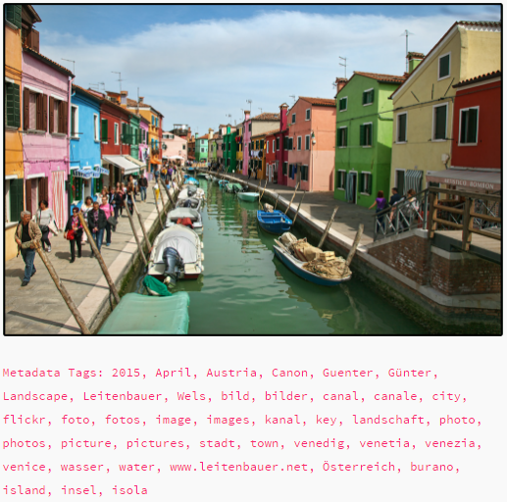
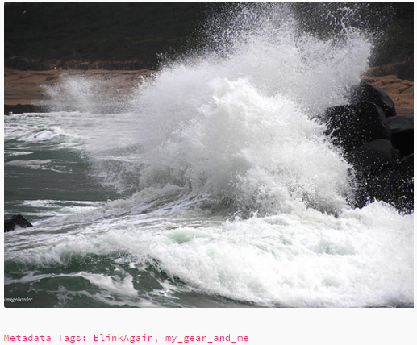
Tagging Issues
Notes:
Noise and relevance
Insufficient metadata

Slide 9
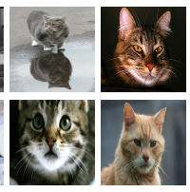
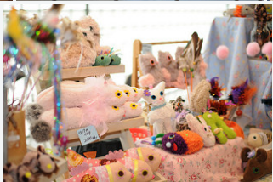
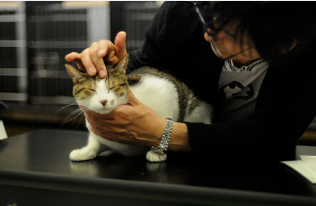
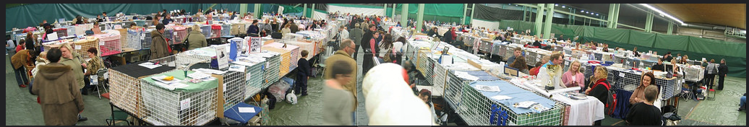
Multiple Object Issues
ImageNet iconic photos
Open source photos

Slide 10
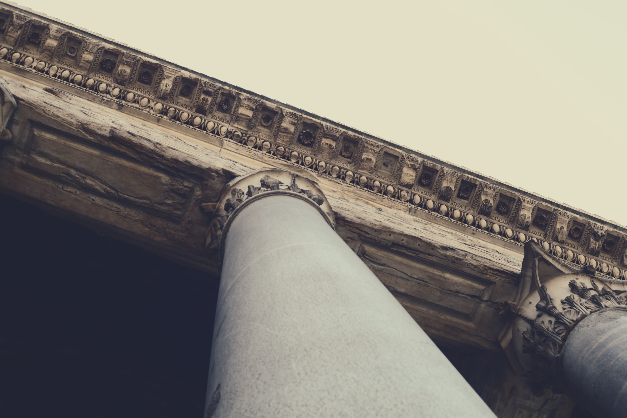
Attalos
Searching images with words

Slide 11

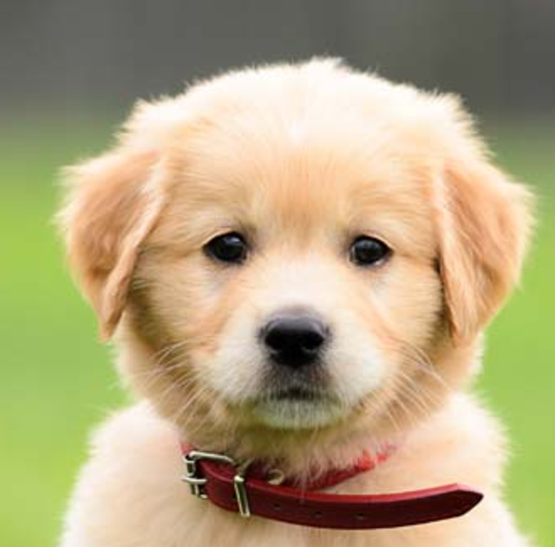
Traditional Optimization of Neural Networks
Final Layer is 2048 x 1000
ImageNet / Visual Genome
Cat
Dog
Car
Tree
Final Layer
1000 Labels
Deep Network
(19 Layers)
Notes:
Timeline slide

Slide 12
Large Number of Labels in YFCC
Final Layer is 2048 x 400,000+
YFCC 100M Tags
Plane
Phone
Canine
Cat
Dog
Car
Tree
K9
Vase
Book
Final Layer
(400k+ Tags)
Deep Network
(19 Layers)
Notes:
Timeline slide

Slide 13
ImageNet / Visual Genome
Cat
Dog
Car
Tree
Final Layer
1000 Labels
Deep Network
(19 Layers)
VS
Open Source Metadata Tags
Plane
Phone
Canine
Cat
Dog
Car
Tree
K9
Vase
Book
Final Layer
(400k+ Tags)
Deep Network
(19 Layers)

Slide 14
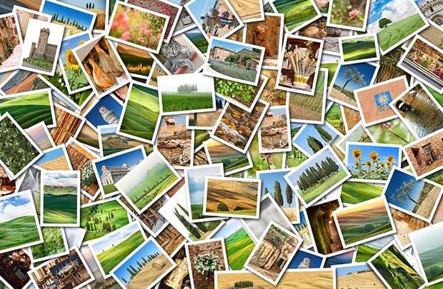
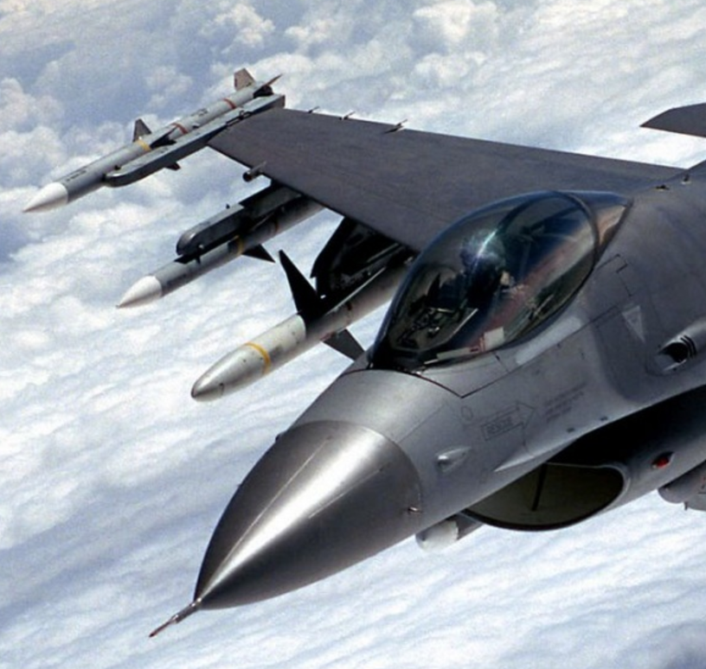
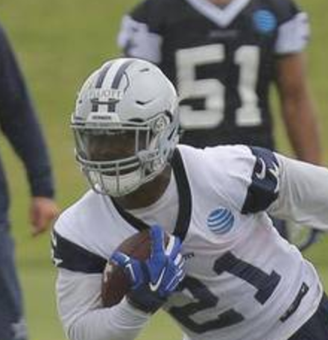
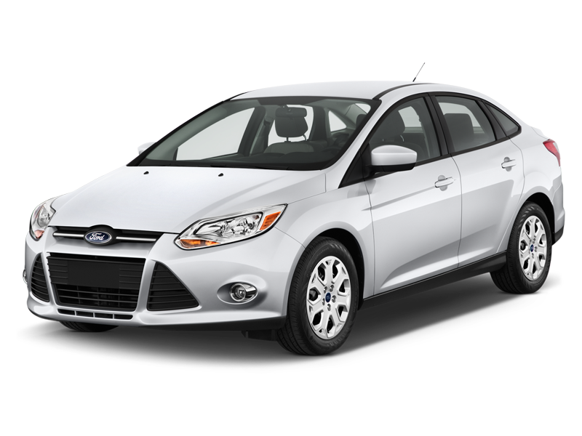
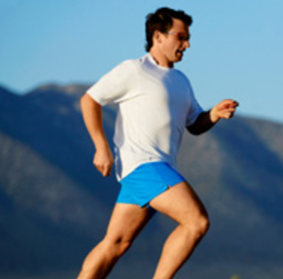
Labels
Cat
Dog
Car
Tree
Jet
Runner
Neural Network
Training Images

Slide 15
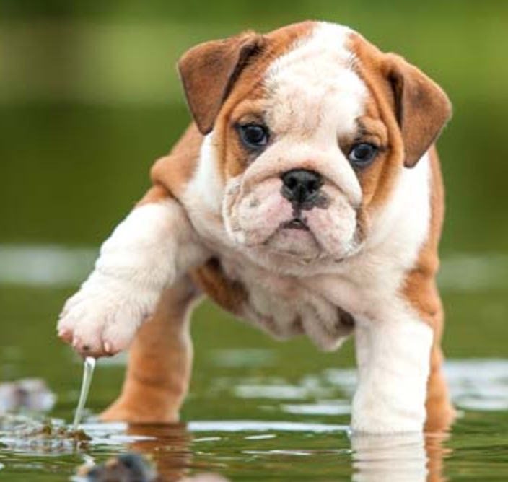
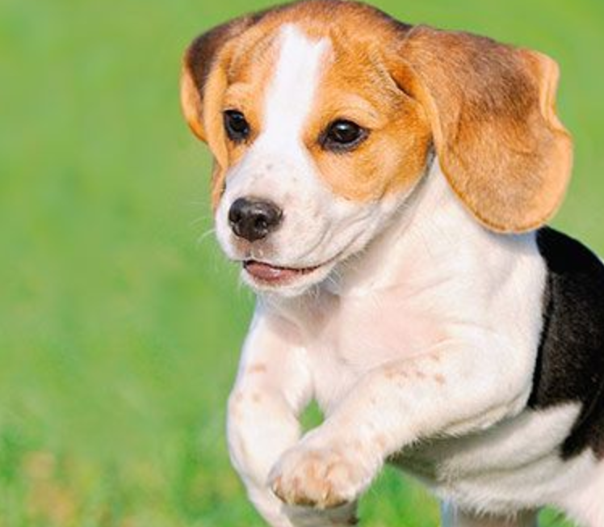
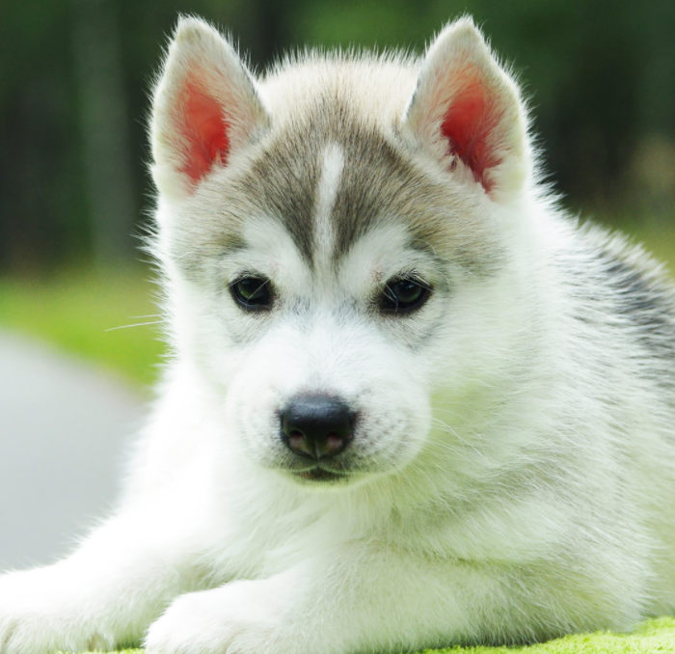
Labels
Cat
Dog
Car
Tree
Jet
Runner
Neural Network
Sample Images
Training Images

Slide 16
Labels
Cat
Dog
Car
Tree
Jet
Runner
Sample Labels
Neural Network
Sample Images
Training Images

Slide 17
Labels
Cat
Dog
Car
Tree
Jet
Runner
Sample Labels
Neural Network
Sample Images
Training Images

Slide 18
Labels
Cat
Dog
Car
Tree
Jet
Runner
Sample Labels
Neural Network
Sample Images
Training Images

Slide 19
Labels
Cat
Dog
Car
Tree
Jet
Runner
Sample Labels
Neural Network
Sample Images
Training Images

Slide 20
Labels
Cat
Dog
Car
Tree
Jet
Runner
Neural Network
Training Images

Slide 21
Labels
Cat
Dog
Car
Tree
Jet
Runner
Neural Network
Sample Images
Training Images

Slide 22
Labels
Cat
Dog
Car
Tree
Jet
Runner
Sample Labels
Neural Network
Sample Images
Training Images

Slide 23
Labels
Cat
Dog
Car
Tree
Jet
Runner
Sample Labels
Neural Network
Sample Images
Training Images

Slide 24
Labels
Cat
Dog
Car
Tree
Jet
Runner
Sample Labels
Neural Network
Sample Images
Training Images

Slide 25
Labels
Cat
Dog
Car
Tree
Jet
Runner
Sample Labels
Neural Network
Sample Images
Training Images

Slide 26
Labels
Cat
Dog
Car
Tree
Jet
Runner
Sample Labels
Neural Network
Sample Images
Training Images

Slide 27
Traditional Optimization (Matrix Vector Format)
Final Layer is 2048 x 400,000+
YFCC 100M Tags
Plane
Phone
Cat
Dog
Car
Tree
Vase
Book
V_{o}
v_{i}
V_{o} = final weights
Column v_{o} in V_{o} = a word
v_{i} = the final image feature
Backpropagation = bad
final image vector
Notes:
Timeline slide
best label = max V_{o}^{T} v_{i}
Particularly bad with a lot of unstructured data and noise

Slide 28
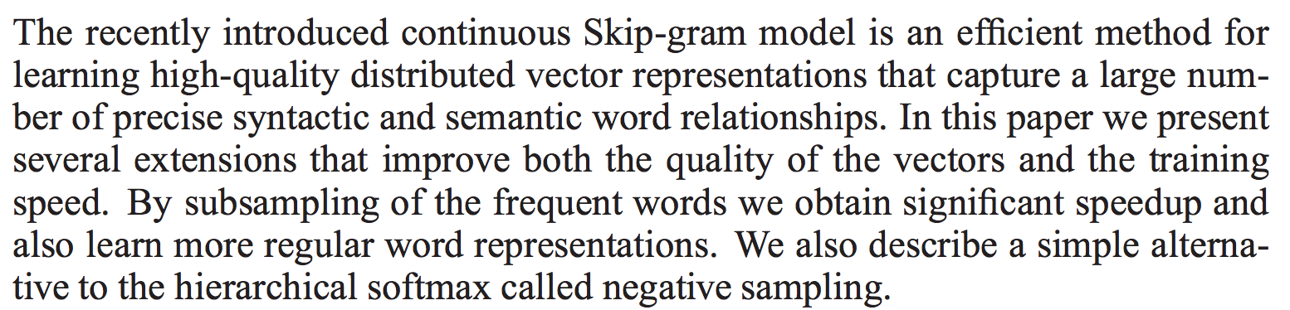
Unstructured data with large vocabulary?
Word Embeddings
v_{i}
optimize the word “vector”
v(t-2)
the context in which “vector” appears
Optimize with respect to context
Sample randomly to provide negative samples
v(t-1)
w(t)
v(t+1)
v(t+2)
Notes:
Word embeddings use context & sampling to optimize word vectors

Slide 29
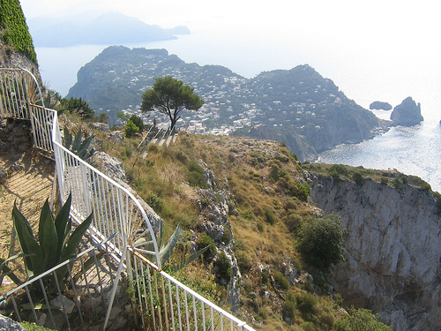
Context of an image
Use the context (i.e., metadata) of an image to define its place in vector space
Metadata from Tags Field
2006 ana+capri capri goats italy mountains naples ocean pompeii rome ski+lift sorrento summer tour vacation venice yachts
Notes:
Timeline slide

Slide 30
Word2Vec (Matrix Vector Format)
Word2Vec deals with large vocabulary
Some Word Corpus
Plane
Phone
Canine
Cat
Dog
Car
Tree
Animal
Vase
Book
V_{o}
v_{i}
Puppy
Take a word and optimize with respect to its context
Randomly sample irrelevant words not in its context
Notes:
Timeline slide

Slide 31
Im2Vec (Matrix Vector Format)
Final Layer is 2048 x 6,000,000
YFCC 100M Tags
Plane
Phone
Canine
Cat
Dog
Car
Tree
Animal
Vase
Book
V_{o}
v_{i}
Final feature must be:
Close to labels
Far from negative samples
Notes:
Timeline slide

Slide 32
Word2Vec vs Im2Vec
Final Layer is 2048 x 6,000,000
Plane
Phone
Canine
Cat
Dog
Car
Tree
Animal
Vase
Book
Original word vector optimization:
Optimization with respect to images:
Notes:
Timeline slide

Slide 33
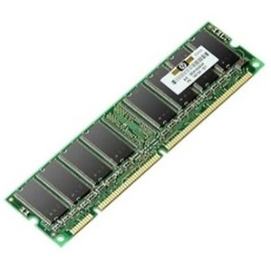

Implementation Specifics I
The GPU/CPU Split
YFCC 100M Tags
Plane
Phone
Canine
Cat
Dog
Car
Tree
Animal
Vase
Wide Optimization on CPU
Deep Optimization on GPU
19 Layers
Notes:
Timeline slide

Slide 34
Implementation Specifics II
Pre-training with word vectors
Plane
Phone
Canine
Cat
Dog
Car
Tree
Animal
Vase
Book
Pre-train on word corpus (YFCC / NYT / Wiki8B)
Either optimize / don’t optimize the final layer
Notes:
TALK ABOUT WHY PRE-TRAINING IN OUR CASE IS SUCH A GOOD IDEA (SO MANY CLASSES!)
Then talk about specific pre-training steps.

Slide 35
Implementation Specifics III
Sampling Methods
Metadata from Tags Field
2006 ana+capri capri goats italy mountains naples ocean pompeii rome ski+lift sorrento summer tour vacation venice yachts
Tensorflow implementation required positive sampling (uniform)
Large distribution negative sampling requires a bit more thought
(Option I) Sample the next image’s labels
(Option II) Pre-sample each epoch
Notes:
TALK ABOUT WHY PRE-TRAINING IN OUR CASE IS SUCH A GOOD IDEA (SO MANY CLASSES!)
Then talk about specific pre-training steps.

Slide 36
Implementation Specifics IV
Out of Vocabulary Words
YFCC 100M Tags
Plane
Phone
Canine
Cat
Dog
Car
Tree
Animal
Vase
Words not in the vocabulary
Update if optimizing last layer
Notes:
Rare: cases when words aren’t in YFCC
I mentioned words

Slide 37
Single Corpus Performance
Small Vocab: IAPRTC
Large Vocab: Visual Genome
Notes:
An example of a bar graph powerpoint slide.
This should be as complex a chart as you show your audience. A good way to enforce discipline is by actually making your bar chart in Powerpoint (instead of importing something from Excel).
The crappy user interface that Powerpoint provides to create a new chart will naturally make you try to present less data.

Slide 38
Multi-Corpora Performance
Train: Visual Genome, Test: ESP Game
Notes:
An example of a bar graph powerpoint slide.
This should be as complex a chart as you show your audience. A good way to enforce discipline is by actually making your bar chart in Powerpoint (instead of importing something from Excel).
The crappy user interface that Powerpoint provides to create a new chart will naturally make you try to present less data.

Slide 39
DEMONSTRATION
http://l41-srv-gpu04.b.internal:5000
Notes:
Add some graphic?

Slide 40

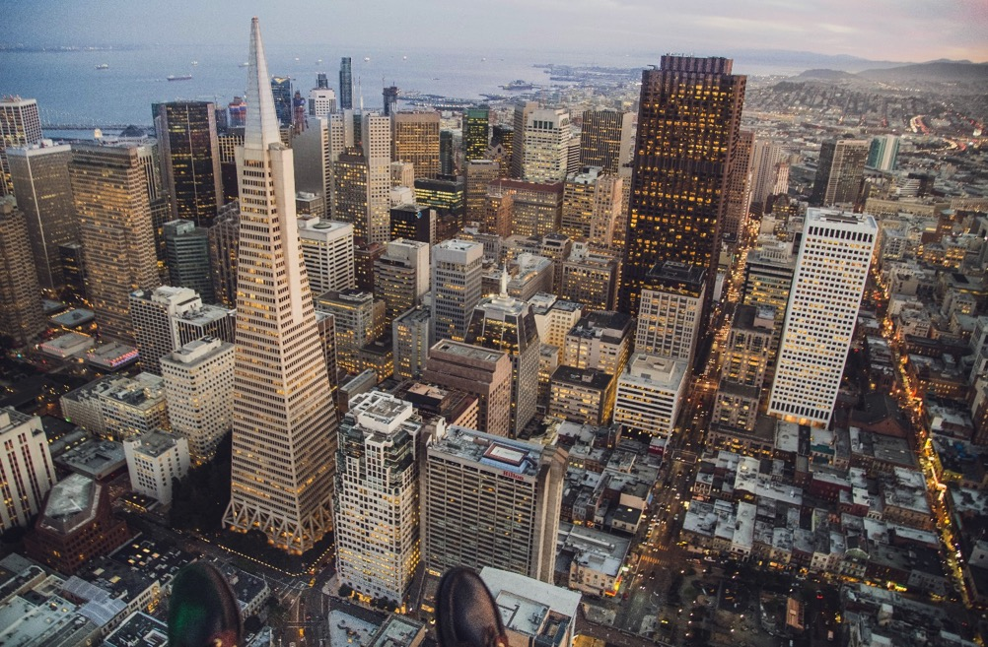




EMAIL
kni@iqt.org
vsandesara@iqt.org
TWITTER
@_lab41
WEBSITE
www.lab41.org
BLOG
gab41.lab41.org
Notes:
Contact slide. Feel free to change to suit your needs

